Slide 1
American History
1
Talk 26: Retreat to Normalcy (1918-1920)
Part Two

Slide 2
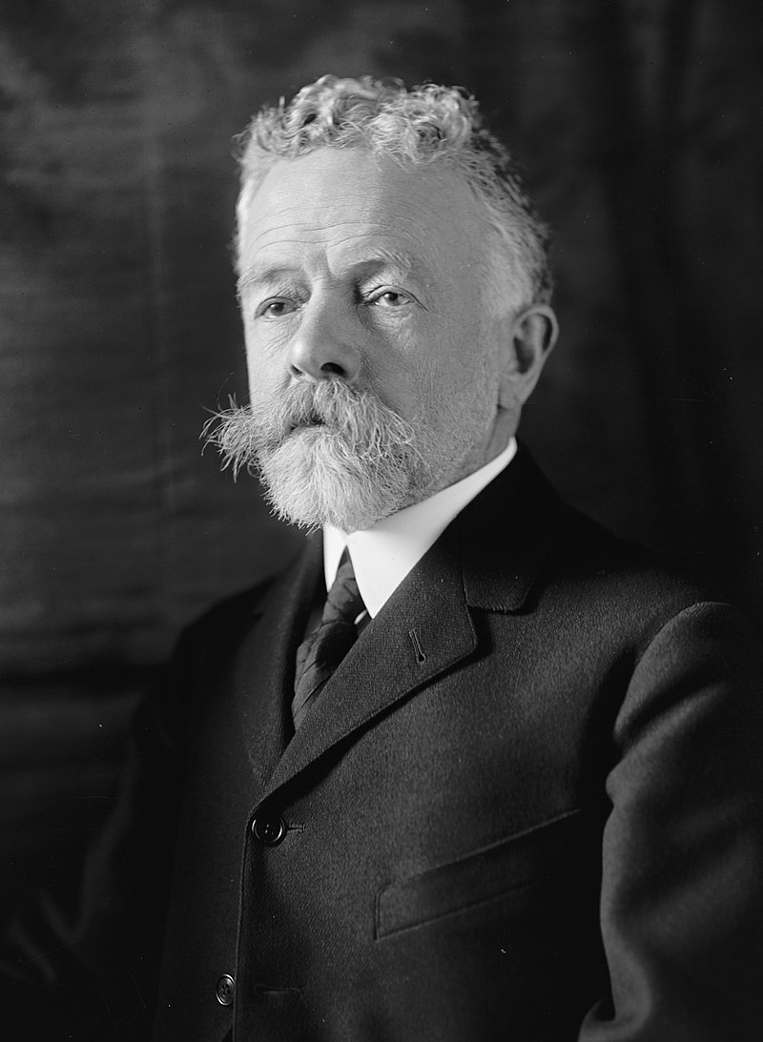
Republican Opposition
Henry Cabot Lodge
1850 -1924)
Massachusetts lawyer
& Ph.D. in History
“Progressive Republican”
Supports civil rights for blacks
Restrictions on immigration to
“more favored races”
Ridicules 14 points. Wilson naive
Internationalist, not US first
"I never expected to hate anyone in
politics with the hatred I feel toward
Wilson."

Slide 3
Isolationism
Lodge “Approves Treaty” …..but with “Reservations”
……“Supports “League but US must be premier power
…….no US involvement in wars of other nations
…….no other nation interference US and its business
“The United States is the world's best hope, but if you fetter her in the interests and quarrels of other nations, if you tangle her in the intrigues of Europe, you will destroy her power for good, and endanger her very existence. Leave her to march freely through the centuries to come, as in the years that have gone. Strong, generous, and confident, she has nobly served mankind. Beware how you trifle with your marvellous inheritance; this great land of ordered liberty. For if we stumble and fall, freedom and civilization everywhere will go down in ruin.”

Slide 4
Wilson Response
Cannot accept any “Reservations”…rejects Lodge
Any compromise with “isolationists” impossible
National Tour to “promote treaty to the people direct”
Collapses October 1919 stroke…incapacitated .. to White House
Mrs Wilson first assumes “stewardship” Female President?

Slide 5
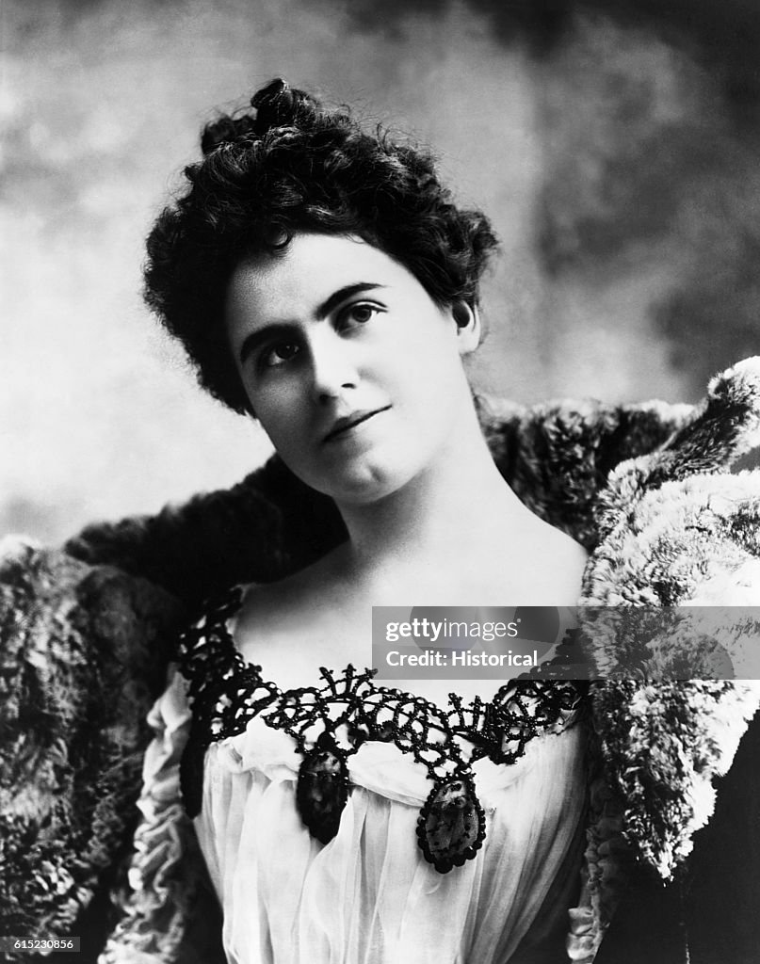
The reign of “Mrs Wilson”
Edith Wilson (1872-1961)
Wilson married Ellen Wilson 1883
3 children
Dies in White House 1914
Wilson depressed
Introduced to Edith Gault 1915
--wealthy widow
--”love at first sight
-- fear of scandal
--- marries W within year of wife’s death
Exemplary First Lady
--war time rationing at White House’
---un mowed lawn
---joins Wilson in Europe
---mixes with dignitaries

Slide 6
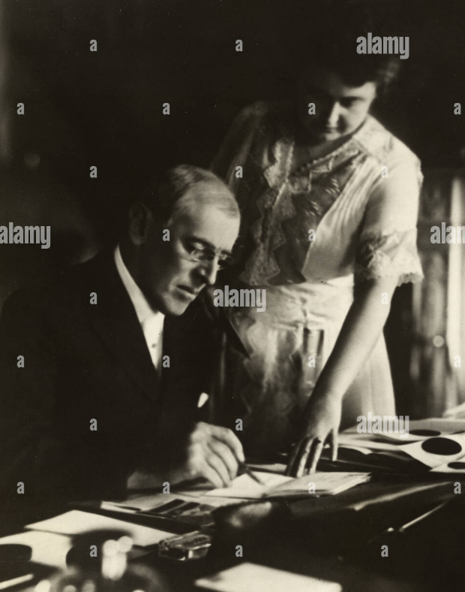
Woodrow and Edith …final year
Woodrow/ Edith share
hatred for VP Marshall
..no attempt to replace
invalid Wilson
Woodrow and Edith 1920
Edith….gate-keeper
--decides what WW sees
--WW invisible 6 months
No compromises made
On treaty….dies
Wilson recovers ability to
Speak July 1920
…Edith assists in meetings
--- Seeks re-election

Slide 7
Election of 1920

Slide 8
The candidates
Democrats
Wilson regains ability to talk April 1920 seeks re-election 3rd term
Discredited…Treaty unpopular….Wilson “sanctimonious”
Pick unknown Governor of Ohio…James Cox + Franklin Delano Roosevelt
Accept “reservations”…but public reject entire Treaty
Republicans
Blocked convention….unable to agree on candidate
Pick Ohio Senator…Warren Harding:
soothing voice/ inoffensive
Ran card games at house
Looked like “silent movie” star ….appeal to the ladies
Calvin Coolidge…breaker of Boston Police Strike VP

Slide 9
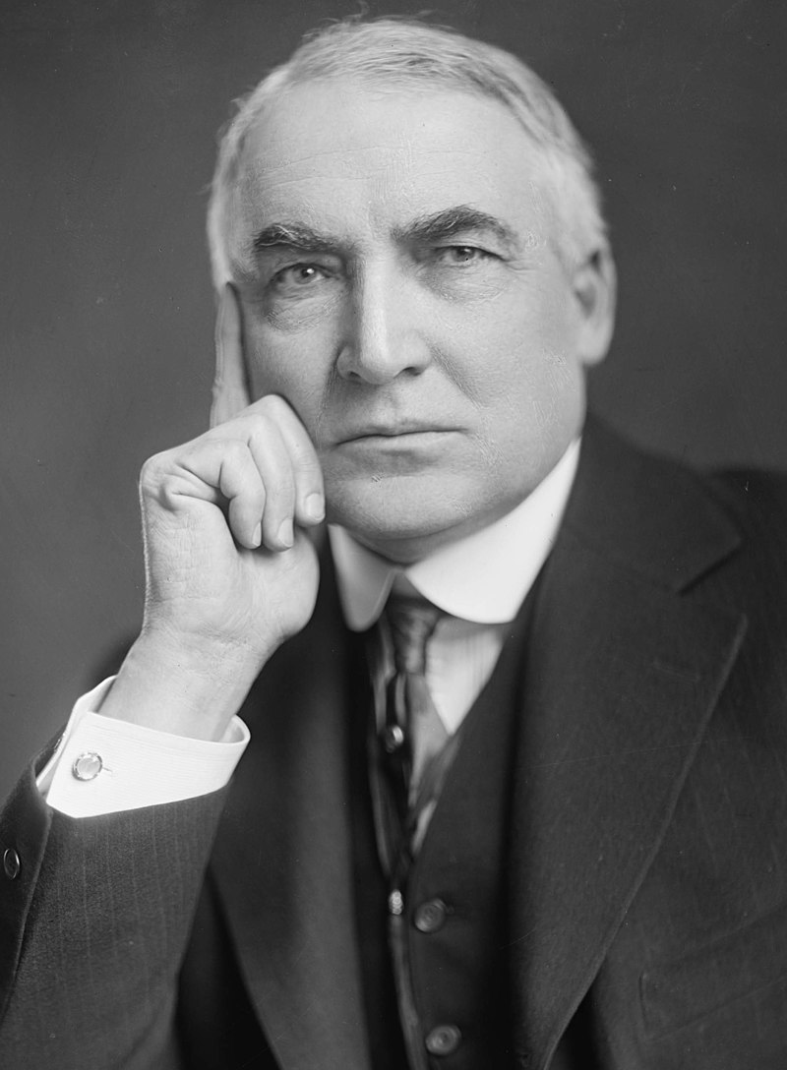
Warren Harding (1865-1923)
Newspaper executive
..State Senator
..Senate…inoffensive
Policies
…pro business/ anti union
…passive support repeal Jim Crow
..peace at home/ abroad
Effective public speaker
"a rambling, high-sounding mixture
of platitudes, patriotism, and pure
nonsense".
Captures tone of nation..
“America's present need is not heroics,
but healing; not nostrums, but normalcy
;not revolution, but restoration."

Slide 10
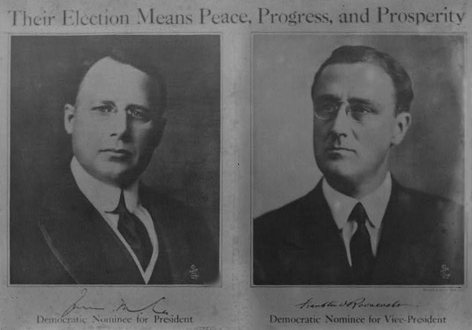
Democrat Poster: Peace for the world

Slide 11
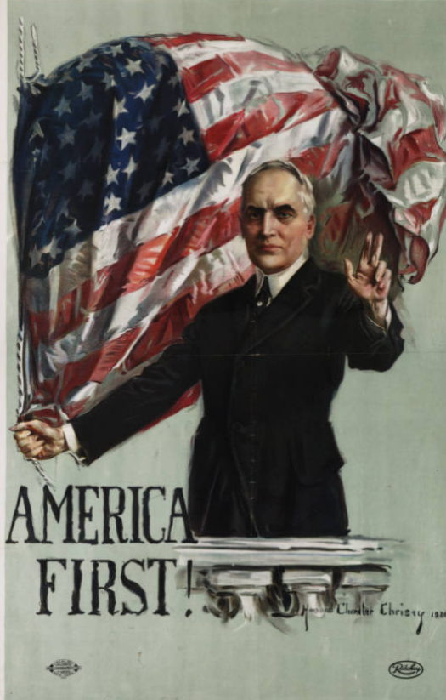
Republican “America First”…(Version 1)

Slide 12
The 1920 Choice
Approve Treaty….now with reservations
US World Leader
Low tariffs to expand Trade
Reform labour laws
White Supremacy
Democrats
“solemn referendum”
Reject Treaty
Disarm/ isolate
Impose Tariffs to protect industry
De regulate Industry/ restrict unions
No mention race
Republicans

Slide 13
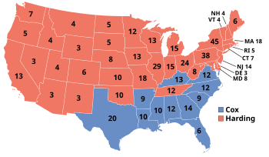
Republican Landslide
Republican Landslide
Harding: 16 million ----56% vote
Democrats :10 million ..…46%
Socialist (Debs in Jail) ..1 million…..4%
Message clear
…Normalcy is what people want
…..prosperity and peace
…USA not world’s policeman

Slide 14
As far as Americans of 1920 were concerned: ….the non US world not its problem ….all the US wanted was to be left alone & debts paid ….what mattered now was the prosperity of Americans
The Roaring Twenties were about to begin…..Talk 26

